Slide 1
[Relative Clauses]
Notes:
Be specific and direct in the title. Use the subtitle to give the specific context of the speech.
-The goal should be to capture the audience’s attention which can be done with a quote, a startling statistic, or fact. It is not necessary to include this attention getter on the slide.

Slide 2
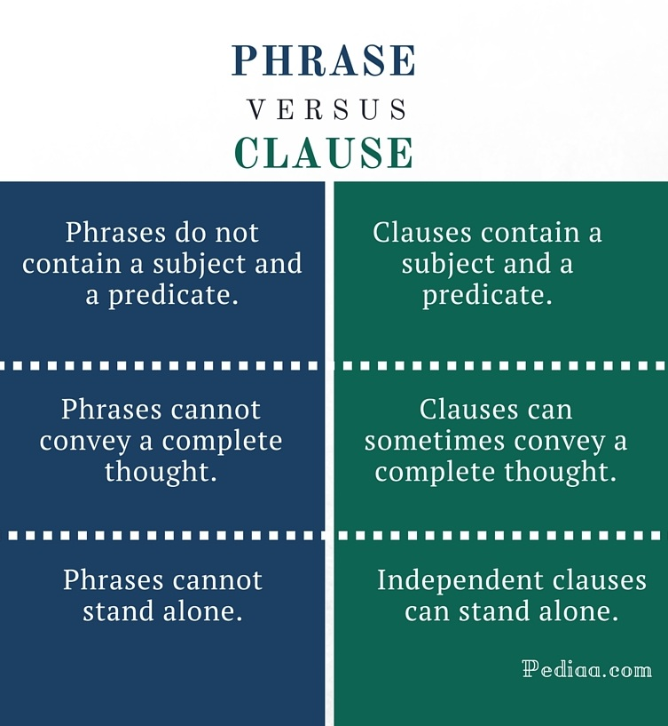
Notes:
Dedicate this entire slide to the thesis statement. It is the reason the speech is being given. Use this time to reveal the three main points of the speech (slides 4,5,6) as an overview for the direction of the speech:
-[type main point #1 here]
-[type main point #2 here]
-[type main point #3 here]
Be sure to transition to the first main point and the next slide.

Slide 3
Clause refers to a group of words having its own subject and predicate but forming only part of a compound or complex sentence (as "when it rained" or "they went inside" in the sentence "when it rained, they went inside"
Notes:
Dedicate this entire slide to the thesis statement. It is the reason the speech is being given. Use this time to reveal the three main points of the speech (slides 4,5,6) as an overview for the direction of the speech:
-[type main point #1 here]
-[type main point #2 here]
-[type main point #3 here]
Be sure to transition to the first main point and the next slide.

Slide 4
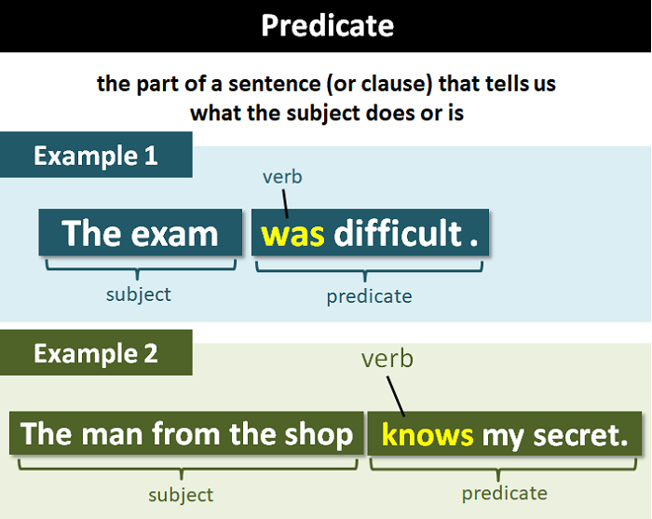
Notes:
Dedicate this entire slide to the thesis statement. It is the reason the speech is being given. Use this time to reveal the three main points of the speech (slides 4,5,6) as an overview for the direction of the speech:
-[type main point #1 here]
-[type main point #2 here]
-[type main point #3 here]
Be sure to transition to the first main point and the next slide.

Slide 5
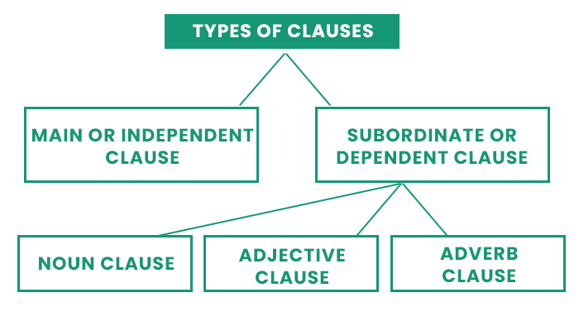
Notes:
Dedicate this entire slide to the thesis statement. It is the reason the speech is being given. Use this time to reveal the three main points of the speech (slides 4,5,6) as an overview for the direction of the speech:
-[type main point #1 here]
-[type main point #2 here]
-[type main point #3 here]
Be sure to transition to the first main point and the next slide.

Slide 6
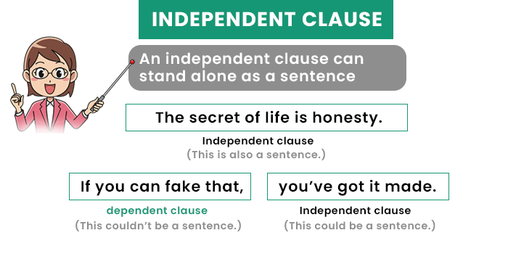
Notes:
Dedicate this entire slide to the thesis statement. It is the reason the speech is being given. Use this time to reveal the three main points of the speech (slides 4,5,6) as an overview for the direction of the speech:
-[type main point #1 here]
-[type main point #2 here]
-[type main point #3 here]
Be sure to transition to the first main point and the next slide.

Slide 7
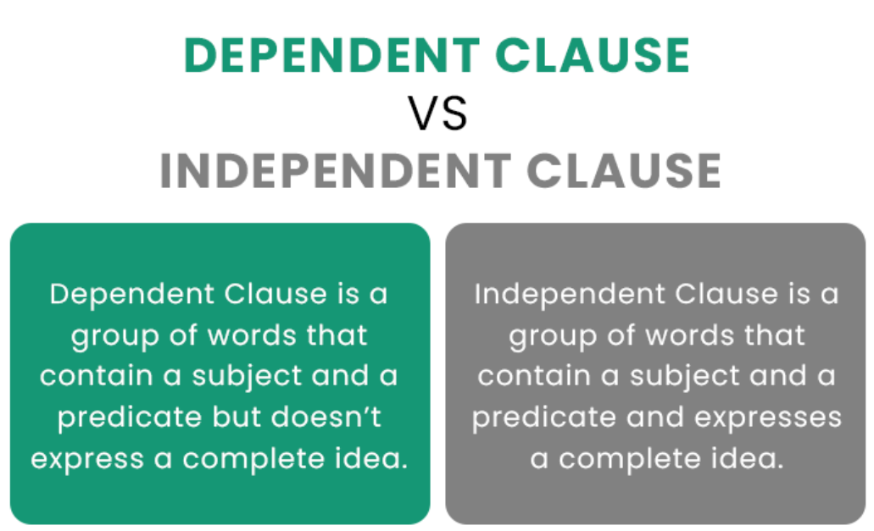
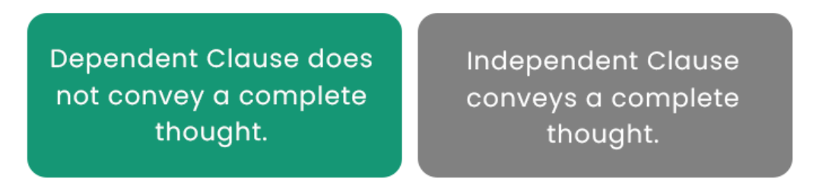
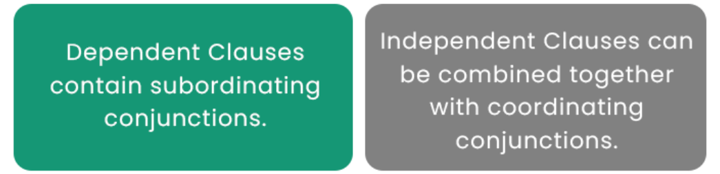
Notes:
Dedicate this entire slide to the thesis statement. It is the reason the speech is being given. Use this time to reveal the three main points of the speech (slides 4,5,6) as an overview for the direction of the speech:
-[type main point #1 here]
-[type main point #2 here]
-[type main point #3 here]
Be sure to transition to the first main point and the next slide.

Slide 8
Subordinate Clauses or Dependent Clauses Subordinate clauses, unlike main clauses, require some assistance to sound right, and they are also known as dependent clauses.
A subordinate clause refers to the clause that, despite having the subject and the verb, cannot exist alone as a complete, meaningful sentence. It does not include a whole thought, as does a major or the main clause. Subordinating conjunction must connect it to the main phrase.
Notes:
Dedicate this entire slide to the thesis statement. It is the reason the speech is being given. Use this time to reveal the three main points of the speech (slides 4,5,6) as an overview for the direction of the speech:
-[type main point #1 here]
-[type main point #2 here]
-[type main point #3 here]
Be sure to transition to the first main point and the next slide.

Slide 9
Subordinate clause instances include :
Sitting gladly, the dog gave birth to puppies.
The Dog, who was producing puppies, sat gladly.
Glancing over the mountain, she moaned sadly.
She growled sadly, glancing over the mountain.
The kid, who was glancing over the hill, moaned sadly.
Notes:
Dedicate this entire slide to the thesis statement. It is the reason the speech is being given. Use this time to reveal the three main points of the speech (slides 4,5,6) as an overview for the direction of the speech:
-[type main point #1 here]
-[type main point #2 here]
-[type main point #3 here]
Be sure to transition to the first main point and the next slide.

Slide 10
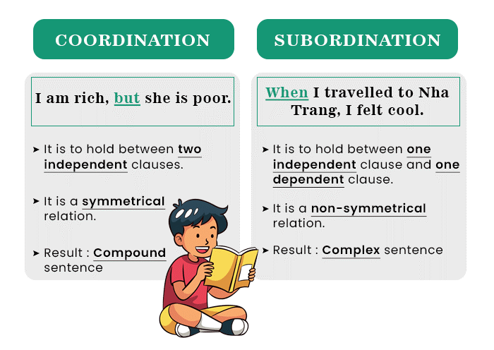
Notes:
Dedicate this entire slide to the thesis statement. It is the reason the speech is being given. Use this time to reveal the three main points of the speech (slides 4,5,6) as an overview for the direction of the speech:
-[type main point #1 here]
-[type main point #2 here]
-[type main point #3 here]
Be sure to transition to the first main point and the next slide.

Slide 11
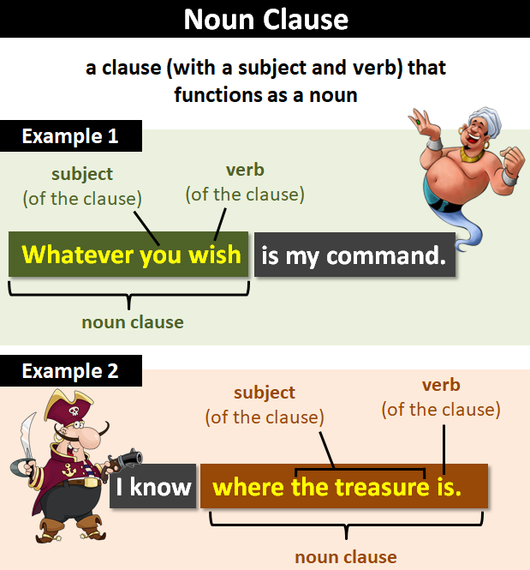
Notes:
Dedicate this entire slide to the thesis statement. It is the reason the speech is being given. Use this time to reveal the three main points of the speech (slides 4,5,6) as an overview for the direction of the speech:
-[type main point #1 here]
-[type main point #2 here]
-[type main point #3 here]
Be sure to transition to the first main point and the next slide.

Slide 12
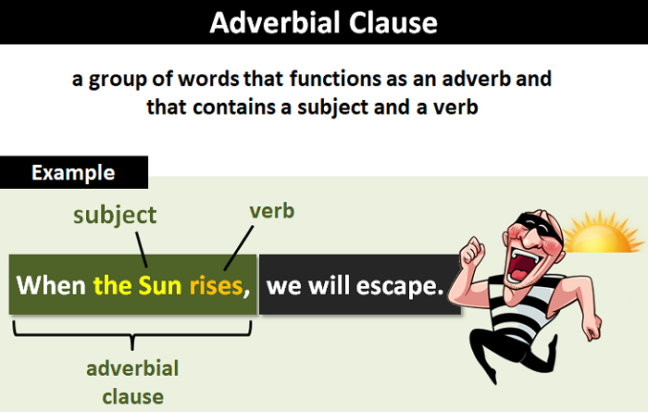
Notes:
Dedicate this entire slide to the thesis statement. It is the reason the speech is being given. Use this time to reveal the three main points of the speech (slides 4,5,6) as an overview for the direction of the speech:
-[type main point #1 here]
-[type main point #2 here]
-[type main point #3 here]
Be sure to transition to the first main point and the next slide.

Slide 13
A relative clause(adjective clause) is dependent clause that identifies a noun or pronoun and functions as an adjective. It starts with the following relative pronouns: Who, Whom, which, that and whose.
Notes:
Dedicate this entire slide to the thesis statement. It is the reason the speech is being given. Use this time to reveal the three main points of the speech (slides 4,5,6) as an overview for the direction of the speech:
-[type main point #1 here]
-[type main point #2 here]
-[type main point #3 here]
Be sure to transition to the first main point and the next slide.

Slide 14
When we think of an adjective, we usually think about a single word used before a noun to modify its meanings (e.g., tall building, smelly cat, argumentative assistant). However, an adjective can also come in the form of an adjective clause. An adjective clause usually comes after the noun it modifies and is made up of several words, which, like all clauses, include a subject and a verb.
Notes:
Dedicate this entire slide to the thesis statement. It is the reason the speech is being given. Use this time to reveal the three main points of the speech (slides 4,5,6) as an overview for the direction of the speech:
-[type main point #1 here]
-[type main point #2 here]
-[type main point #3 here]
Be sure to transition to the first main point and the next slide.

Slide 15
Here are some examples of adjective clauses: The carpets that you bought last year have rotted. The follies which a man regrets most in his life are those which he didn't commit when he had the opportunity. (US journalist Helen Rowland, 1876-1950) (Even though this is a quotation by an American journalist, nowadays, most writers in the US would use ‘that’ instead of ‘which’.) Bore: a person who talks when you wish him to listen.
Notes:
Dedicate this entire slide to the thesis statement. It is the reason the speech is being given. Use this time to reveal the three main points of the speech (slides 4,5,6) as an overview for the direction of the speech:
-[type main point #1 here]
-[type main point #2 here]
-[type main point #3 here]
Be sure to transition to the first main point and the next slide.

Slide 16
The Components of an Adjective Clause
An adjective clause (also called a relative clause) will have the following three traits:
Trait 1. It will start with a relative pronoun (who, whom, whose, that, or which) or a relative adverb (when, where, or why).(This links it to the noun it is modifying.) (Note: Quite often, the relative pronoun can be omitted. However, with an adjective clause, it is always possible to put one in. There is more on this below.)
Trait 2. It will have a subject and a verb.(These are what make it a clause.)
Trait 3. It will tell us something about the noun.(This is why it is a kind of adjective.)
Notes:
Dedicate this entire slide to the thesis statement. It is the reason the speech is being given. Use this time to reveal the three main points of the speech (slides 4,5,6) as an overview for the direction of the speech:
-[type main point #1 here]
-[type main point #2 here]
-[type main point #3 here]
Be sure to transition to the first main point and the next slide.

Slide 17
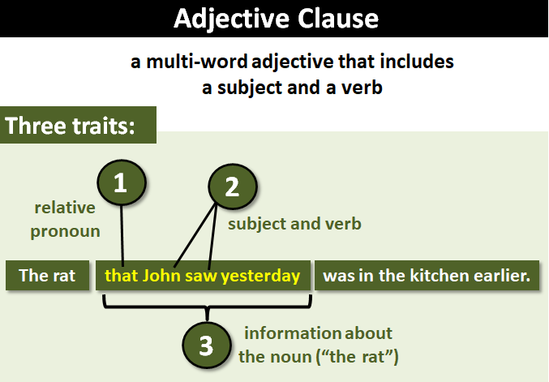
Notes:
Dedicate this entire slide to the thesis statement. It is the reason the speech is being given. Use this time to reveal the three main points of the speech (slides 4,5,6) as an overview for the direction of the speech:
-[type main point #1 here]
-[type main point #2 here]
-[type main point #3 here]
Be sure to transition to the first main point and the next slide.

Slide 18
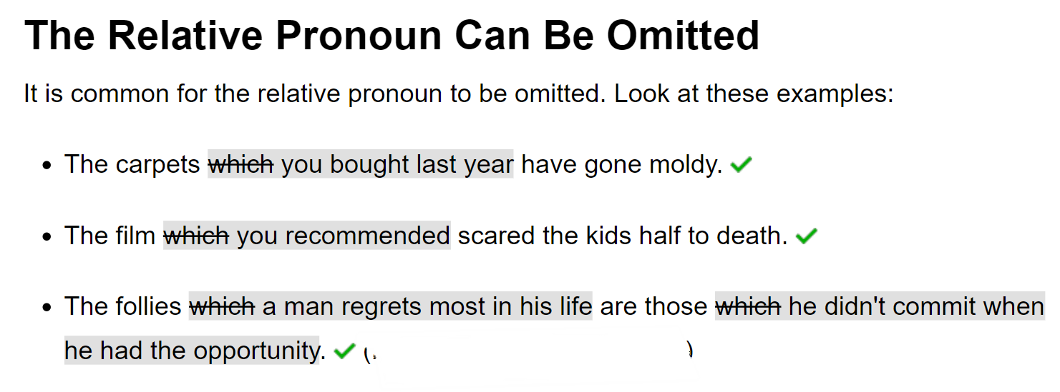
The Components of an Adjective Clause
Notes:
Dedicate this entire slide to the thesis statement. It is the reason the speech is being given. Use this time to reveal the three main points of the speech (slides 4,5,6) as an overview for the direction of the speech:
-[type main point #1 here]
-[type main point #2 here]
-[type main point #3 here]
Be sure to transition to the first main point and the next slide.

Slide 19
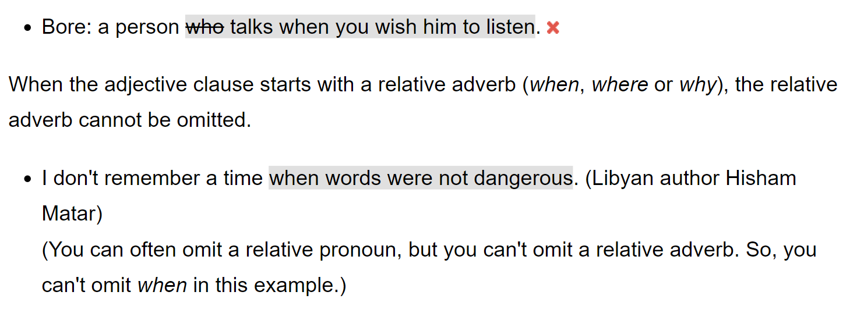
Omitting Relative Pronoun isn’t always possible: See following example
Notes:
Dedicate this entire slide to the thesis statement. It is the reason the speech is being given. Use this time to reveal the three main points of the speech (slides 4,5,6) as an overview for the direction of the speech:
-[type main point #1 here]
-[type main point #2 here]
-[type main point #3 here]
Be sure to transition to the first main point and the next slide.

Slide 20
Use of commas in Relative Clauses
Don't use commas if your clause is essential; i.e., it is required to identify its noun. (This is called a restrictive clause.)
Do use commas if your clause is just additional information. (This is called a non-restrictive clause.)
Notes:
Dedicate this entire slide to the thesis statement. It is the reason the speech is being given. Use this time to reveal the three main points of the speech (slides 4,5,6) as an overview for the direction of the speech:
-[type main point #1 here]
-[type main point #2 here]
-[type main point #3 here]
Be sure to transition to the first main point and the next slide.

Slide 21
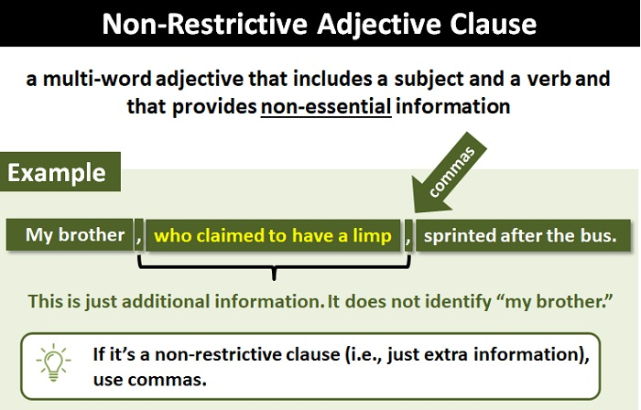

Slide 22
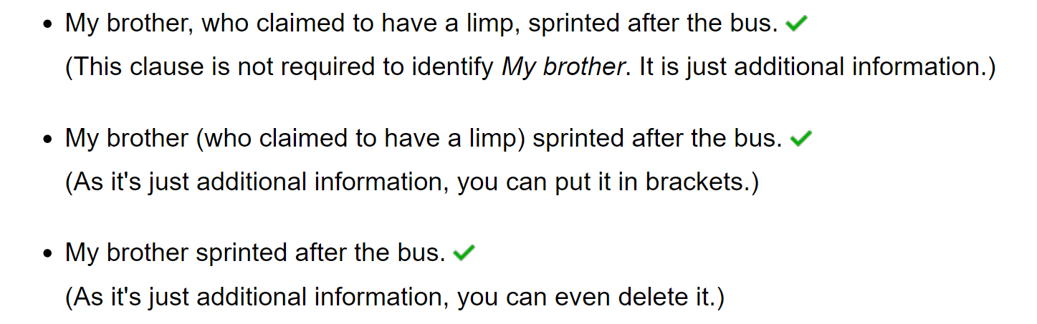
Use of commas in Relative Clauses
Notes:
Dedicate this entire slide to the thesis statement. It is the reason the speech is being given. Use this time to reveal the three main points of the speech (slides 4,5,6) as an overview for the direction of the speech:
-[type main point #1 here]
-[type main point #2 here]
-[type main point #3 here]
Be sure to transition to the first main point and the next slide.

Slide 23
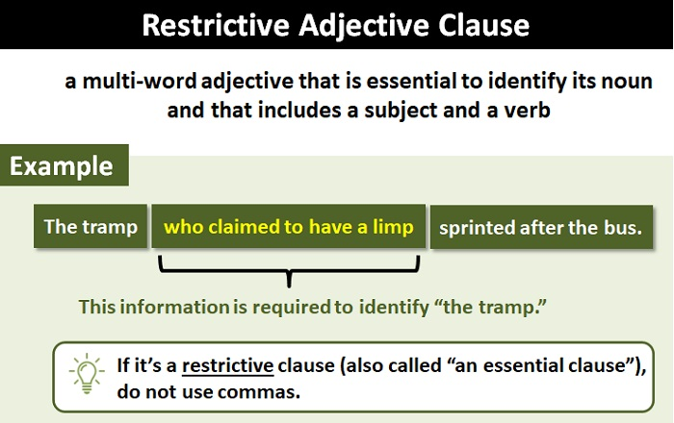

Slide 24
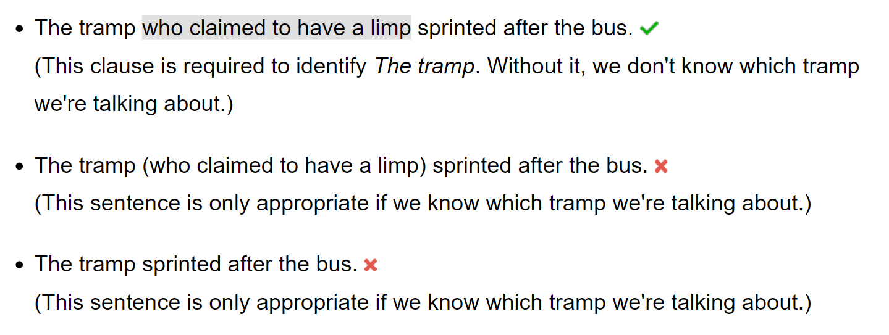
Use of commas in Relative Clauses
Notes:
Dedicate this entire slide to the thesis statement. It is the reason the speech is being given. Use this time to reveal the three main points of the speech (slides 4,5,6) as an overview for the direction of the speech:
-[type main point #1 here]
-[type main point #2 here]
-[type main point #3 here]
Be sure to transition to the first main point and the next slide.

Slide 25
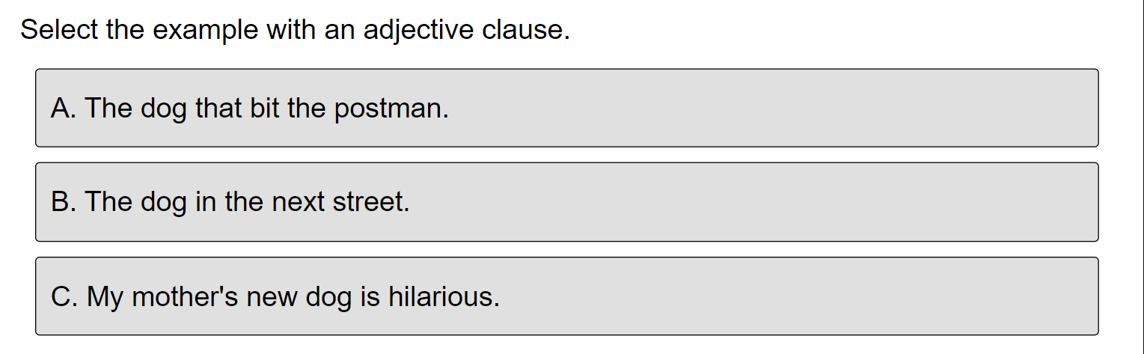
Quiz-1
Notes:
Dedicate this entire slide to the thesis statement. It is the reason the speech is being given. Use this time to reveal the three main points of the speech (slides 4,5,6) as an overview for the direction of the speech:
-[type main point #1 here]
-[type main point #2 here]
-[type main point #3 here]
Be sure to transition to the first main point and the next slide.

Slide 26
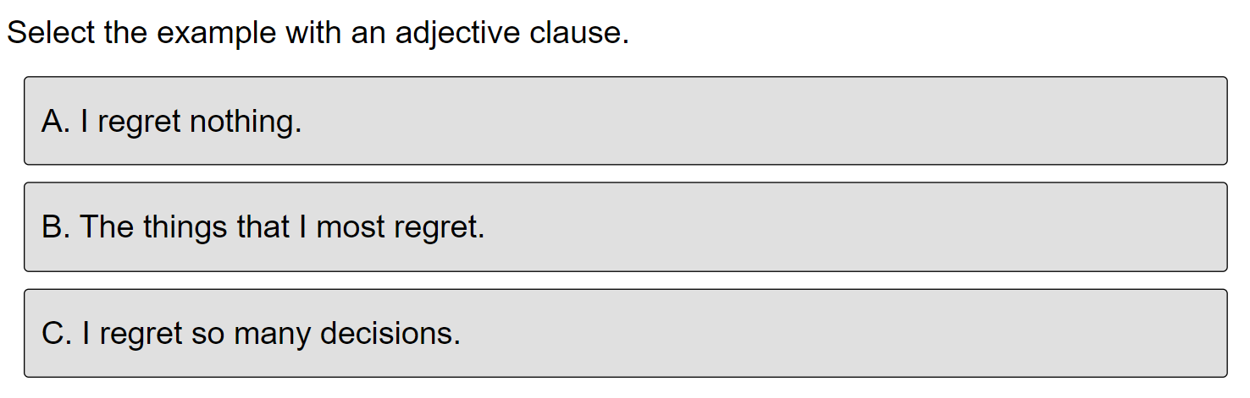
Quiz-2
Notes:
Dedicate this entire slide to the thesis statement. It is the reason the speech is being given. Use this time to reveal the three main points of the speech (slides 4,5,6) as an overview for the direction of the speech:
-[type main point #1 here]
-[type main point #2 here]
-[type main point #3 here]
Be sure to transition to the first main point and the next slide.

Slide 27
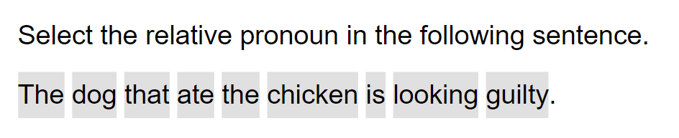
Quiz-3
Notes:
Dedicate this entire slide to the thesis statement. It is the reason the speech is being given. Use this time to reveal the three main points of the speech (slides 4,5,6) as an overview for the direction of the speech:
-[type main point #1 here]
-[type main point #2 here]
-[type main point #3 here]
Be sure to transition to the first main point and the next slide.

Slide 28
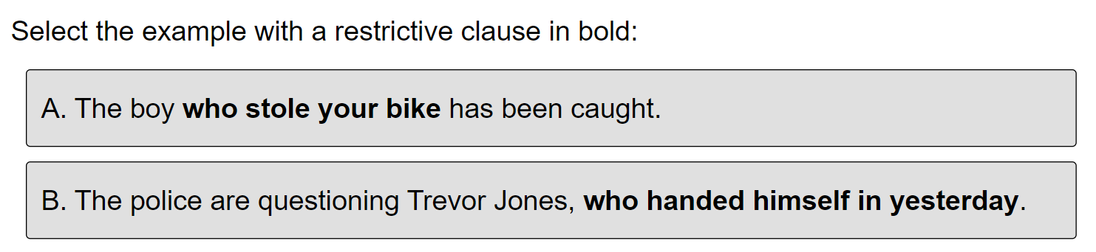
Quiz-4
Notes:
Dedicate this entire slide to the thesis statement. It is the reason the speech is being given. Use this time to reveal the three main points of the speech (slides 4,5,6) as an overview for the direction of the speech:
-[type main point #1 here]
-[type main point #2 here]
-[type main point #3 here]
Be sure to transition to the first main point and the next slide.

Slide 29
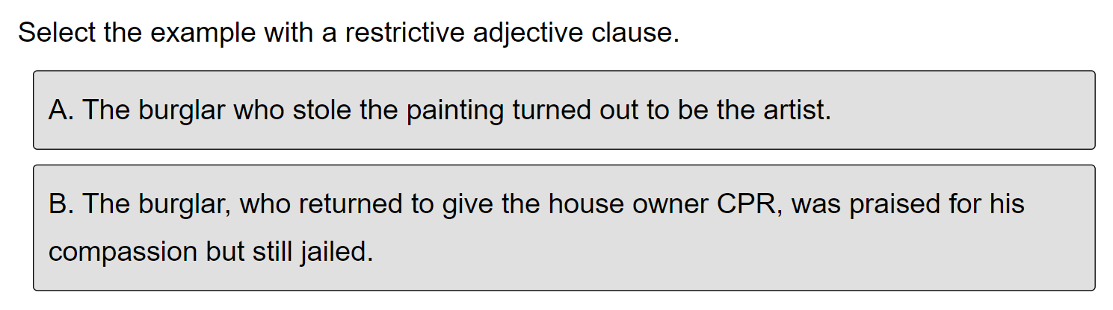
Quiz-5
Notes:
Dedicate this entire slide to the thesis statement. It is the reason the speech is being given. Use this time to reveal the three main points of the speech (slides 4,5,6) as an overview for the direction of the speech:
-[type main point #1 here]
-[type main point #2 here]
-[type main point #3 here]
Be sure to transition to the first main point and the next slide.

Slide 30
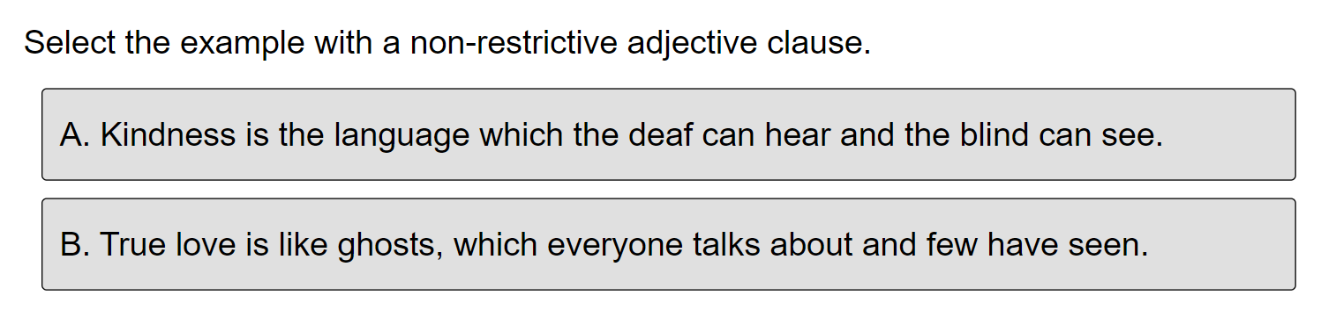
Quiz-6
Notes:
Dedicate this entire slide to the thesis statement. It is the reason the speech is being given. Use this time to reveal the three main points of the speech (slides 4,5,6) as an overview for the direction of the speech:
-[type main point #1 here]
-[type main point #2 here]
-[type main point #3 here]
Be sure to transition to the first main point and the next slide.

Slide 31
Answers
A
B
That
A
A
B
Notes:
Dedicate this entire slide to the thesis statement. It is the reason the speech is being given. Use this time to reveal the three main points of the speech (slides 4,5,6) as an overview for the direction of the speech:
-[type main point #1 here]
-[type main point #2 here]
-[type main point #3 here]
Be sure to transition to the first main point and the next slide.

Slide 32
EXERCISES
Notes:
Dedicate this entire slide to the thesis statement. It is the reason the speech is being given. Use this time to reveal the three main points of the speech (slides 4,5,6) as an overview for the direction of the speech:
-[type main point #1 here]
-[type main point #2 here]
-[type main point #3 here]
Be sure to transition to the first main point and the next slide.

Slide 33
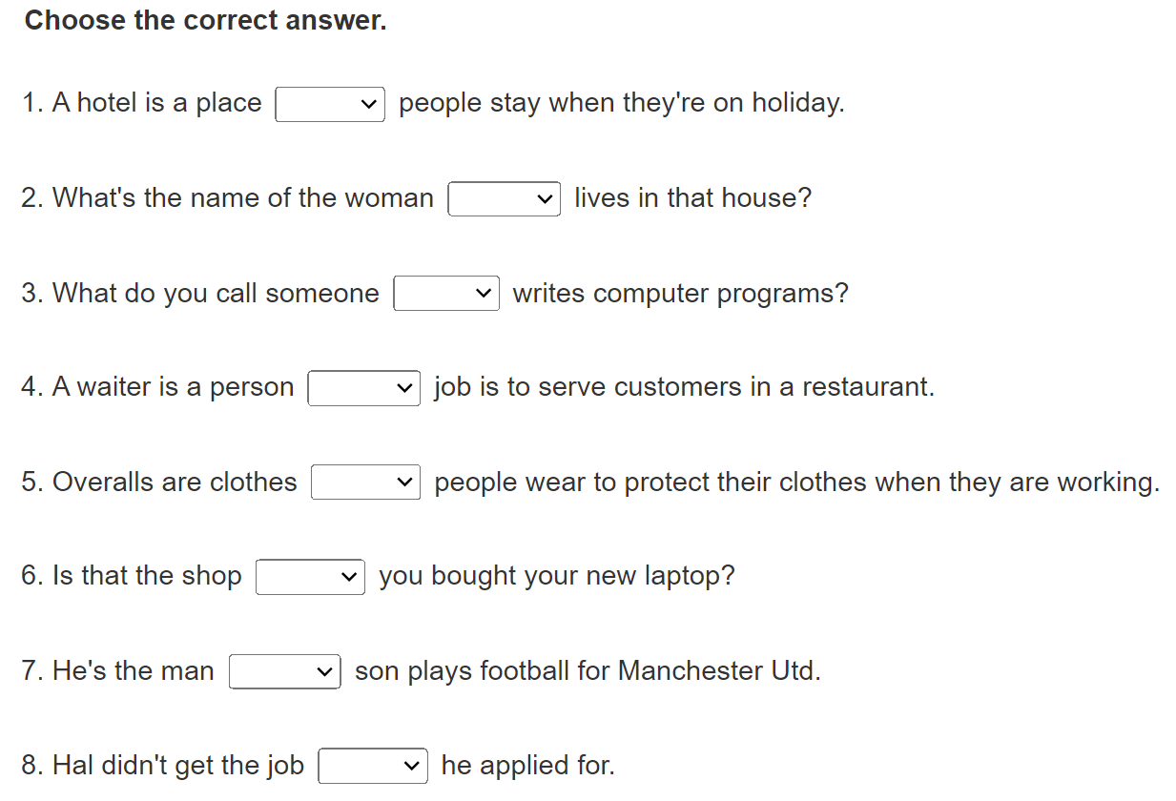
Notes:
Dedicate this entire slide to the thesis statement. It is the reason the speech is being given. Use this time to reveal the three main points of the speech (slides 4,5,6) as an overview for the direction of the speech:
-[type main point #1 here]
-[type main point #2 here]
-[type main point #3 here]
Be sure to transition to the first main point and the next slide.

Slide 34
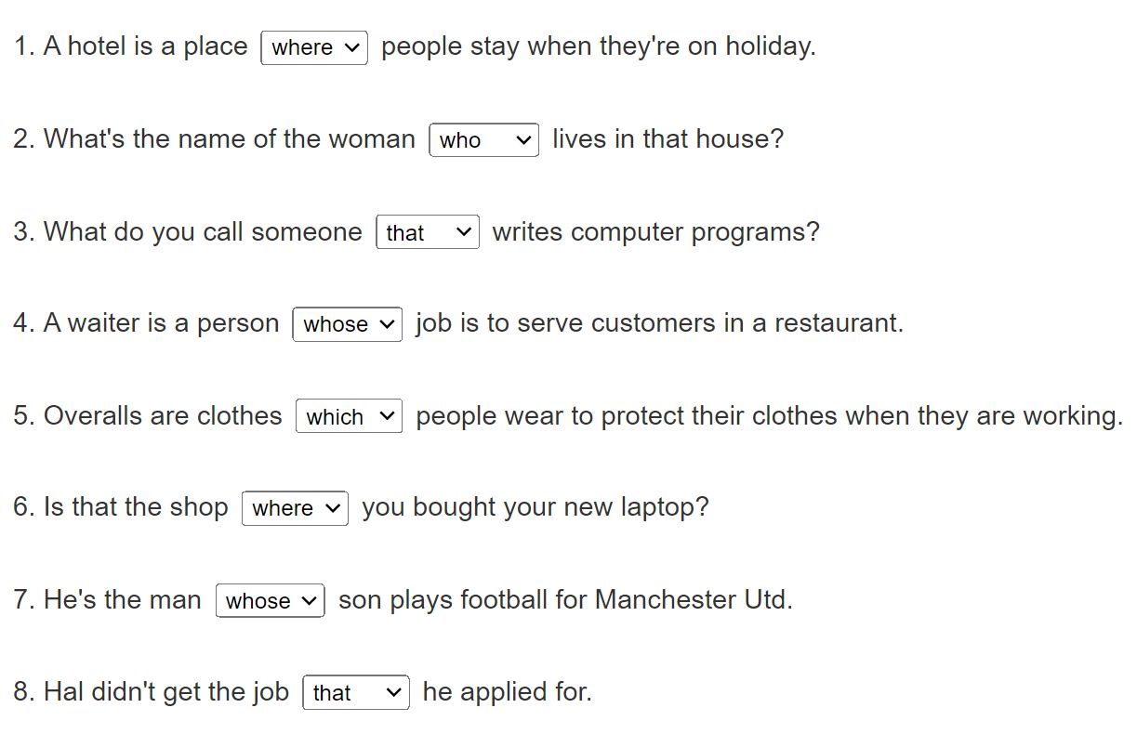
Notes:
Dedicate this entire slide to the thesis statement. It is the reason the speech is being given. Use this time to reveal the three main points of the speech (slides 4,5,6) as an overview for the direction of the speech:
-[type main point #1 here]
-[type main point #2 here]
-[type main point #3 here]
Be sure to transition to the first main point and the next slide.

Slide 35
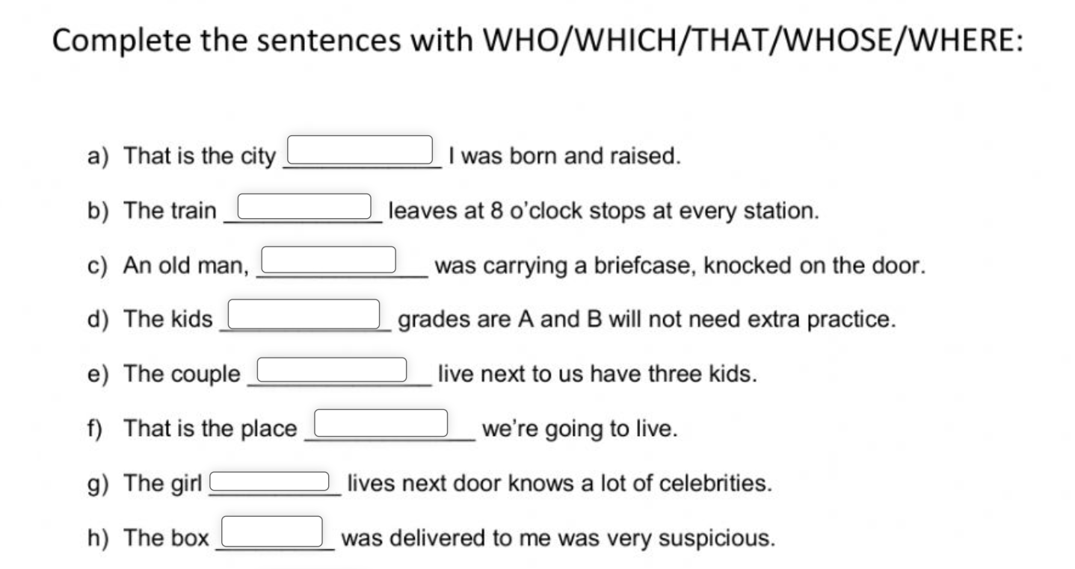
Notes:
Dedicate this entire slide to the thesis statement. It is the reason the speech is being given. Use this time to reveal the three main points of the speech (slides 4,5,6) as an overview for the direction of the speech:
-[type main point #1 here]
-[type main point #2 here]
-[type main point #3 here]
Be sure to transition to the first main point and the next slide.

Slide 36
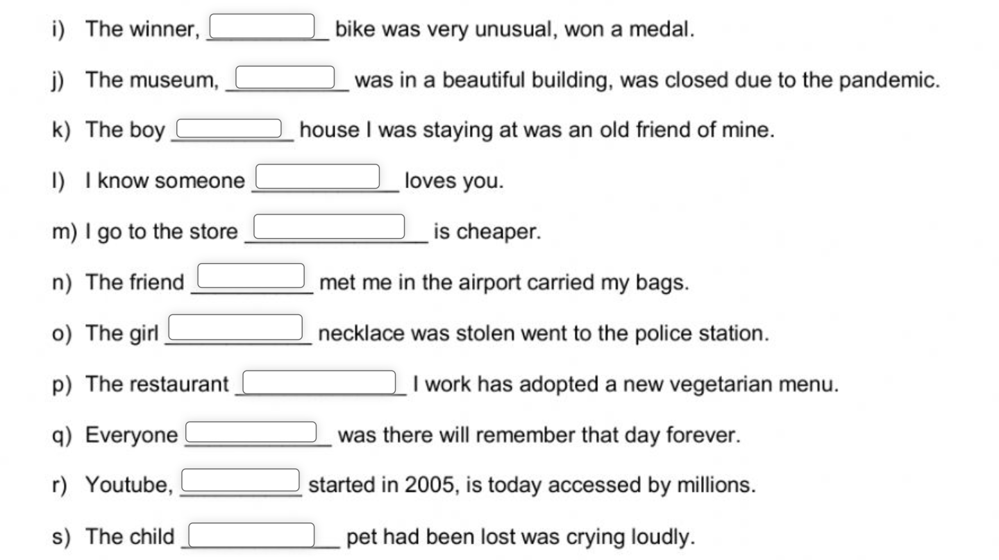
Notes:
Dedicate this entire slide to the thesis statement. It is the reason the speech is being given. Use this time to reveal the three main points of the speech (slides 4,5,6) as an overview for the direction of the speech:
-[type main point #1 here]
-[type main point #2 here]
-[type main point #3 here]
Be sure to transition to the first main point and the next slide.

Slide 37
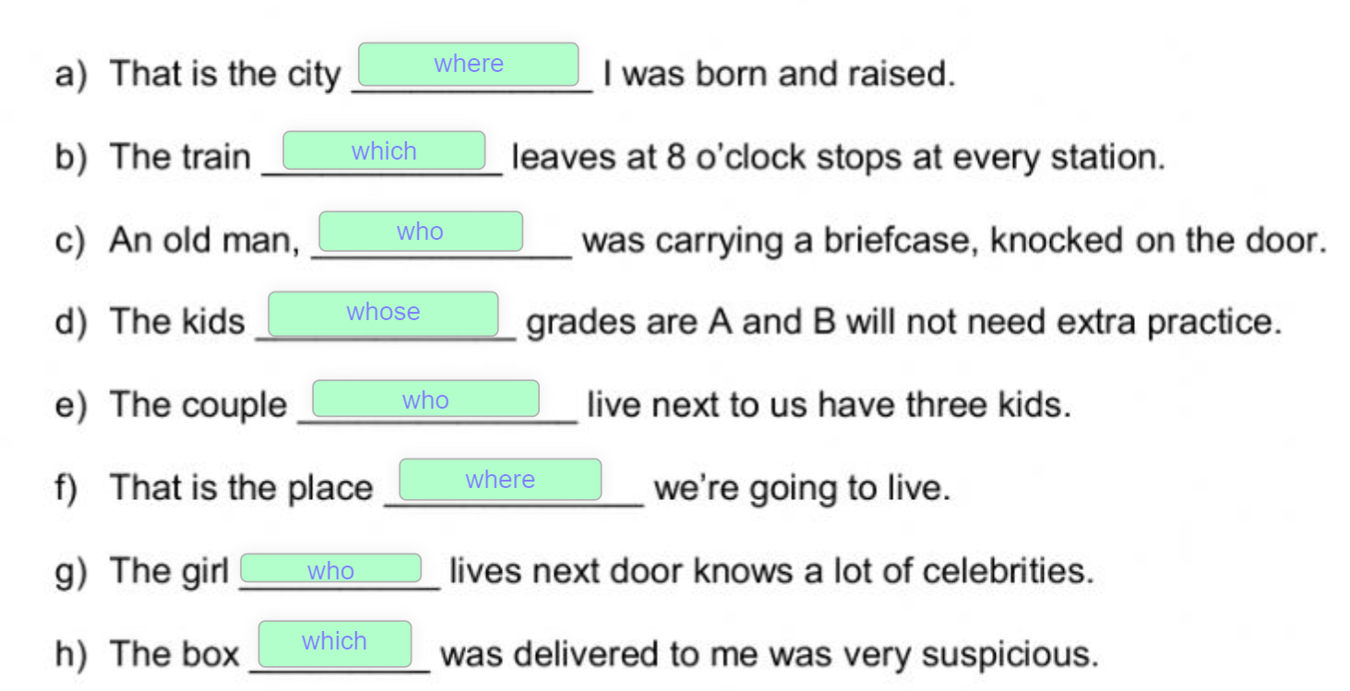
Notes:
Dedicate this entire slide to the thesis statement. It is the reason the speech is being given. Use this time to reveal the three main points of the speech (slides 4,5,6) as an overview for the direction of the speech:
-[type main point #1 here]
-[type main point #2 here]
-[type main point #3 here]
Be sure to transition to the first main point and the next slide.

Slide 38
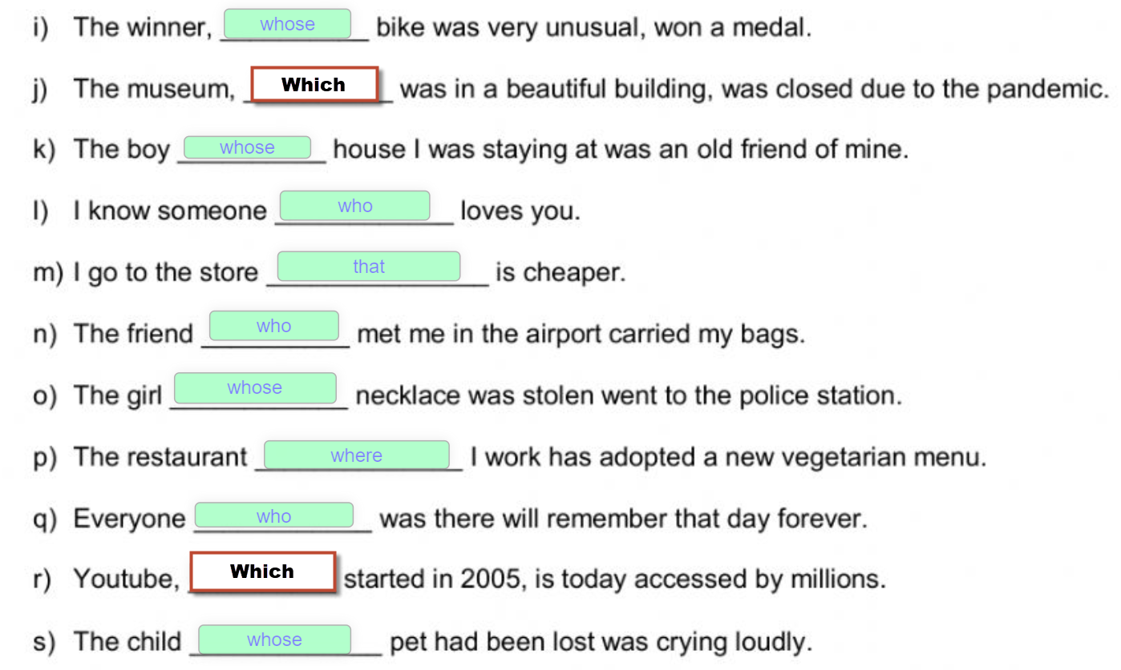
Notes:
Dedicate this entire slide to the thesis statement. It is the reason the speech is being given. Use this time to reveal the three main points of the speech (slides 4,5,6) as an overview for the direction of the speech:
-[type main point #1 here]
-[type main point #2 here]
-[type main point #3 here]
Be sure to transition to the first main point and the next slide.

Slide 39
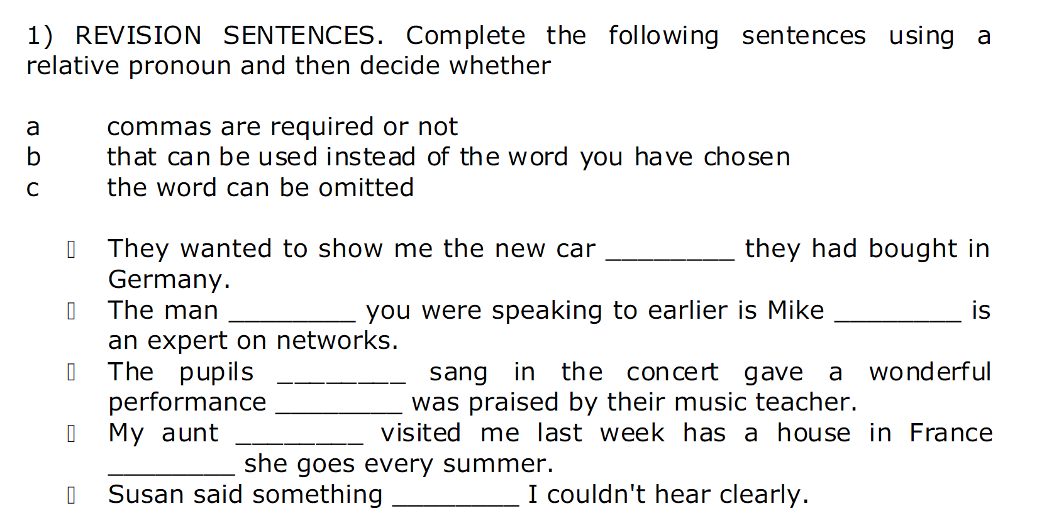
Notes:
Dedicate this entire slide to the thesis statement. It is the reason the speech is being given. Use this time to reveal the three main points of the speech (slides 4,5,6) as an overview for the direction of the speech:
-[type main point #1 here]
-[type main point #2 here]
-[type main point #3 here]
Be sure to transition to the first main point and the next slide.

Slide 40
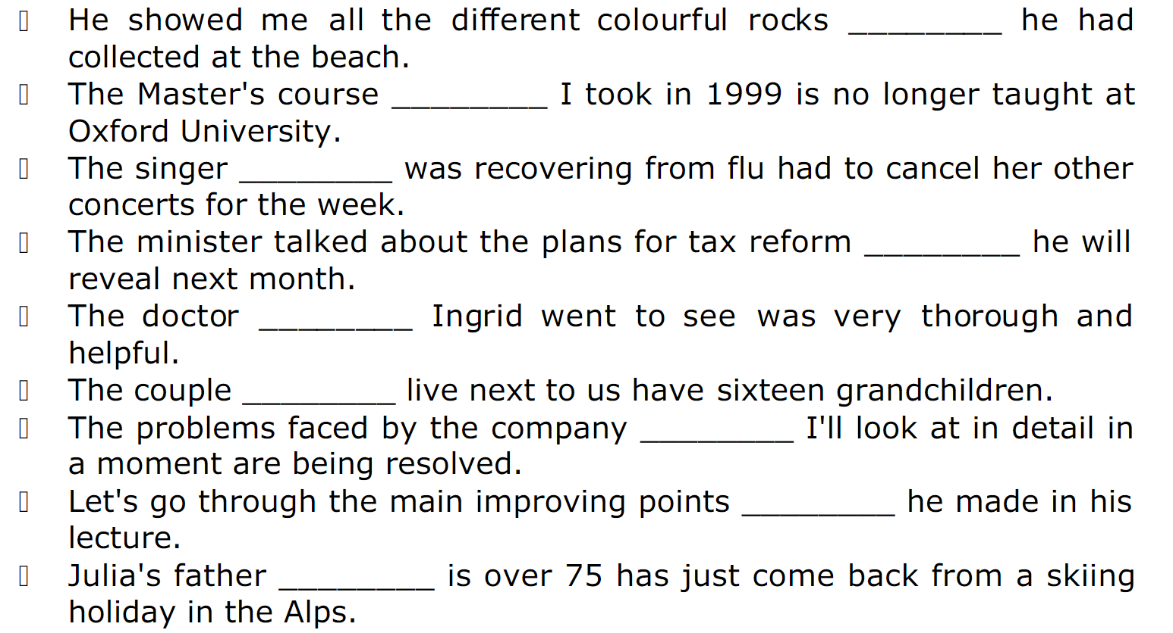
Notes:
Dedicate this entire slide to the thesis statement. It is the reason the speech is being given. Use this time to reveal the three main points of the speech (slides 4,5,6) as an overview for the direction of the speech:
-[type main point #1 here]
-[type main point #2 here]
-[type main point #3 here]
Be sure to transition to the first main point and the next slide.

Slide 41
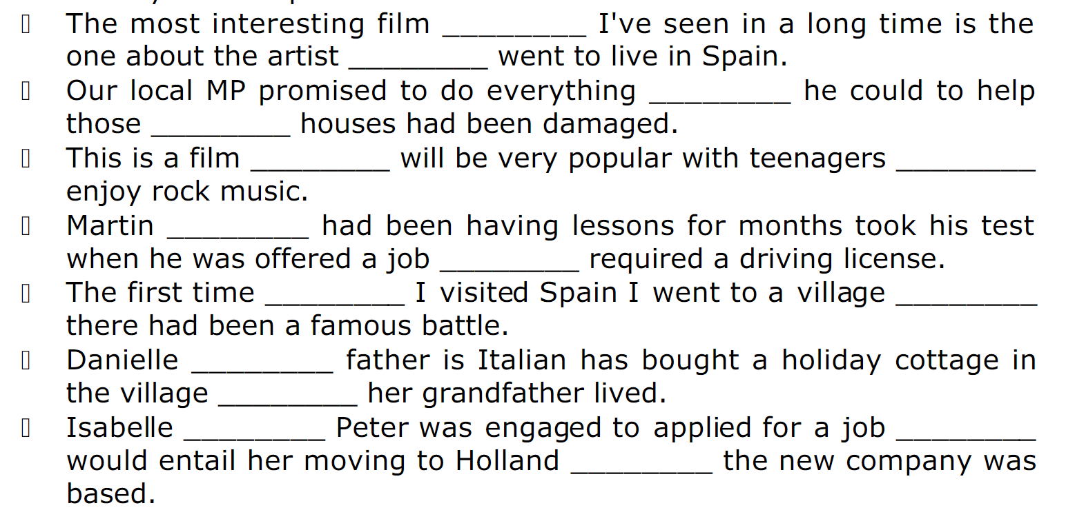
Notes:
Dedicate this entire slide to the thesis statement. It is the reason the speech is being given. Use this time to reveal the three main points of the speech (slides 4,5,6) as an overview for the direction of the speech:
-[type main point #1 here]
-[type main point #2 here]
-[type main point #3 here]
Be sure to transition to the first main point and the next slide.

Slide 42
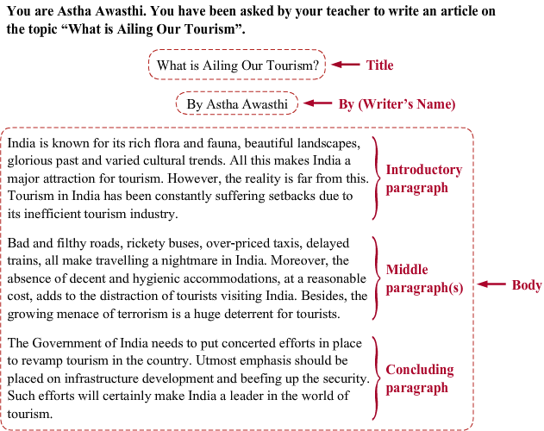

Slide 43
